Slide 1


Interrupt

Slide 2
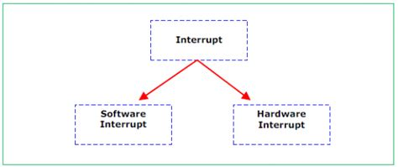
What is an Interrupt Signal?
An interrupt is a signal sent from a device or from software to the processor.
This will cause the processor to temporarily stop what it is doing and service the interrupt. Interrupts can be caused by, for example
timing signal
input/output processes (a disk drive is ready to receive more data, for example)
a hardware fault (an error has occurred such as a paper jam in a printer,
user interaction (the user pressed a key to interrupt the current process, such as <CTRL><ALT><BREAK>,
a software error that cannot be ignored (if an .exe file could not be found to initiate the execution of a program OR an attempt to divide by zero.

Slide 3
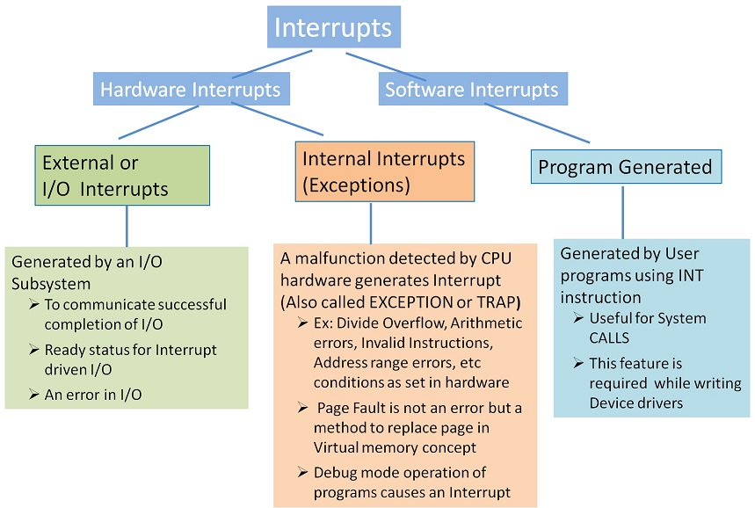
Interrupt- types
Hardware interrupt: is a signal sent by a hardware device or a specific condition in the computer's hardware. Example
When a peripheral device (e.g., a keyboard, mouse, disk drive) needs attention, it can send an interrupt request to the CPU to indicate that data is ready to be transferred.
A system timer generates regular interrupts such as scheduling tasks, keeping track of time, and triggering time-sensitive events.
Detecting an error or a critical condition (e.g., overheating, power failure).

Slide 4
Interrupt- types
Software interrupt also known as a trap or exception, is a mechanism used by a program to request a service from the operating system or to signal an event that needs attention.
Example
When a program needs to perform operations that require higher privileges or access to resources managed by the operating system (such as file I/O, network communication, etc.)
If an error condition occurs during program execution, the program might trigger a software interrupt to handle the error such as like displaying an error message or terminating the program.
A program might generate a software interrupt to indicate a specific event, such as a division by zero or an illegal instruction.

Slide 5
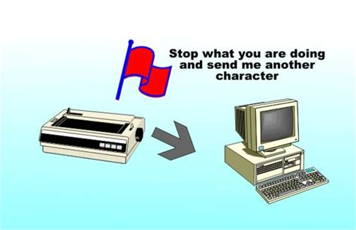
Interrupt Priority
Once the interrupt signal is received, the processor either carries on with what it was doing or stops to service the device/program that generated the interrupt.
The computer needs to identify the interrupt type and also establish the level of interrupt priority.

Slide 6
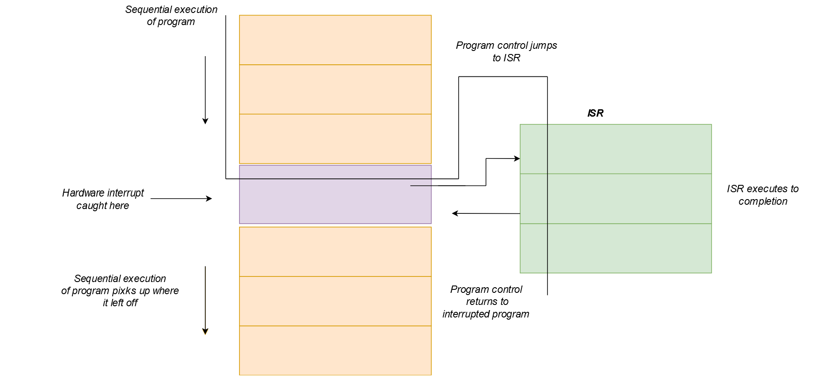
What is an interrupt handler?
Interrupt handlers, also commonly known as Interrupt service routine (ISR), is a block of code that is associated with a specific interrupt condition
Interrupt handlers are responsible for handling interrupts promptly and effectively.
Their primary role is to service interrupts and perform necessary actions associated with specific events.
Interrupt handlers ensure that time-critical tasks, such as responding to user input or processing data from hardware devices, are addressed in a timely manner.

Slide 7
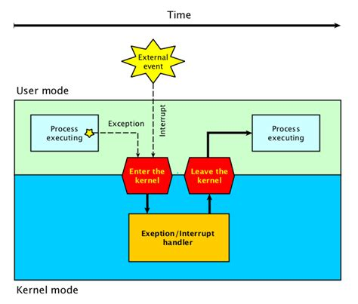
Interrupt Service Routine (ISR)
An ISR (also called an interrupt handler) is generated by an interrupt request from a hardware device. The request is sent to the CPU, interrupting the active process. When the ISR is complete, the process is resumed.
How it works?
When a device raises an interrupt at let’s say process “I”, the processor first completes the execution of instruction “I”.
Then it loads the Program Counter (PC) with the address of the first instruction of the ISR.
Before loading the Program Counter with the address, the address of the interrupted instruction is moved to a temporary location.
Therefore, after handling the interrupt the processor can continue with process “I”+1.

Slide 8
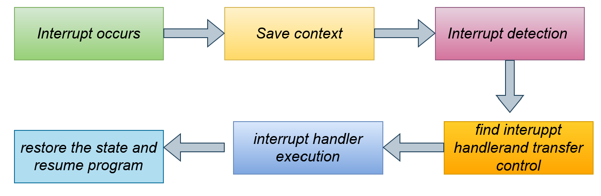
How the processor handle an interrupt
When an interrupt occurs
the processor first saves the current state of the interrupted program, including register values and the program counter.
It then identifies the specific interrupt request (IRQ) associated with the event and acknowledges the interrupt.
The processor uses the interrupt number or IRQ line to locate the corresponding interrupt handler in the interrupt vector table (IVT).
The control is transferred to the interrupt handler's memory address, where the necessary code is executed to handle the interrupt.
The interrupt handler performs actions specific to the interrupt, such as interacting with hardware devices or processing data.

Slide 9
How the processor handle an interrupt
Once the interrupt is handled, the saved state is restored, and the interrupted program resumes execution from where it left off.
This workflow ensures that interrupt events are promptly addressed while preserving the integrity of the interrupted program.
By saving and restoring the program state, interrupt handling ensures that the interrupted program can easily resume execution after the interrupt is serviced.

Slide 10
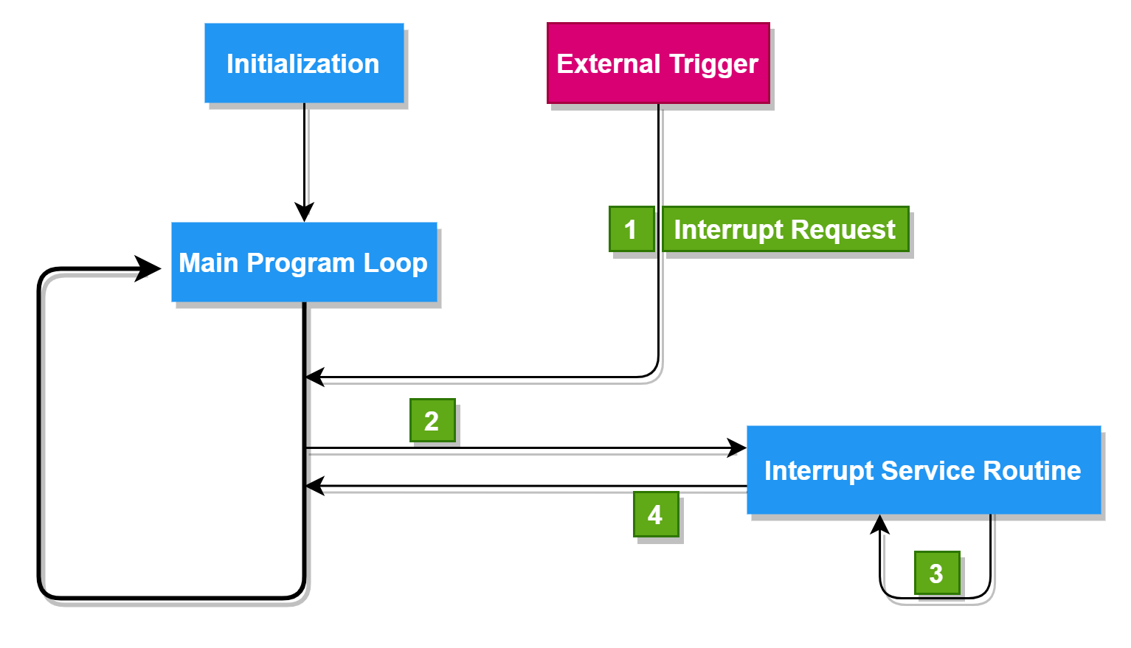
How interrupt are handled by different processor
RISC processors due to their simplified instruction set and architecture, often handle interrupts in a straightforward and efficient manner.
Support multiple interrupt levels or priority levels. This allows the processor to prioritize interrupts based on their urgency or importance.
When an interrupt occurs, the processor checks the priority of the interrupt against the current priority level, and if necessary, switches to a higher-priority task.
It uses a simple interrupt vector table (IVT) to store the addresses of the Interrupt Service Routines (ISRs).
It uses the interrupt number to index the IVT and retrieve the address of the corresponding ISR.
To prevent nested interrupts, RISC processors often disable further interrupts while processing the current one.

Slide 11


Thank you

